Slide 1


Smart Snacks
In School
USDA’s “All Foods Sold in School” Nutrition Standards
New for Snacks and Beverages

Slide 2

Presentation Outline
Overview of USDA’s Smart Snacks in School Nutrition Standards
  What is the purpose
  When and where do the standards apply
  Why are the standards necessary
  How were the standards determined
  “Smart Snacks in School” Timeline
  Student Nutrition Associations’ (SNA) Comments
Nutrition Standards for Foods
  General nutrition standards
  Food accompaniments
  Fundraisers
Nutrition Standards for Beverages
  Beverages allowed for all grade levels
  Caffeine standards
Comparison of Before and After New Standards
Monitoring and Compliance
Implementation and Support
Resources for More Information

Slide 3

New Nutrition Standards Overview
As a part of the Healthy Hunger-Free Kids Act of 2010, the new Smart Snacks in School rules affect “competitive foods” sold in schools, which include vending machines, a la carte lunch lines, and in student stores. These snacks and beverages are purchased outside of the regular meals provided by the school, and “compete” with the nutritionally regulated and reimbursable national school lunch and breakfast programs.

Slide 4
Potential effects of Smart Snack Standard Implementation
Compromise revenue stream
Establish a uniform description of healthy snacks on campus
Broaden the scope of the School Nutrition Director and
Administration staff
Promote students bringing their own snacks
Question who, what, and how nutrition education is provided
Clarify fundraising exemption by MDE

Slide 5
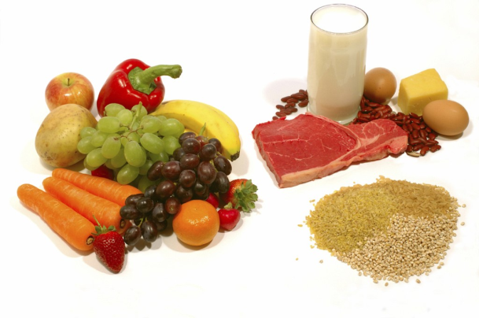
What do the new standards do?
Allow schools to offer healthier snack foods and limit ”junk foods”
Set standards for fat, saturated fat, sugar and sodium content
Promote snacks that have main ingredient listed as either:
  Whole grain
  Low-fat dairy
  Fruit
  Vegetable
  Protein

Slide 6
Where do the standards apply?
School campus: All areas of the property under the jurisdiction of the school that are accessible to students during the school day.

Slide 7
When do the standards apply?
New standards begin July 1, 2014
Schools are allowed one year, the current 2013-2014 academic school year to make necessary adjustments to the school food environment.
USDA offers training and technical assistance as schools transition to the new standards.
Provide feedback to USDA during implementation.

Slide 8
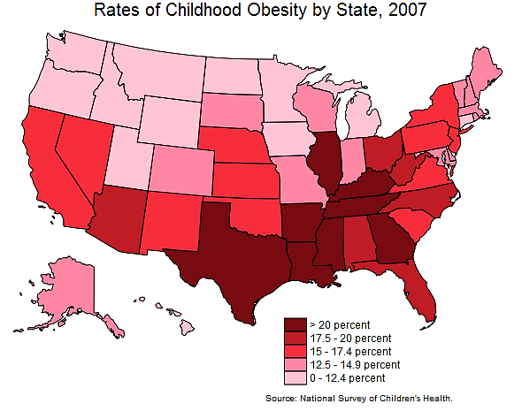
Why are the new standards necessary?
Nearly one third of children in America are at risk for preventable diseases such as diabetes and heart disease due to being overweight or obese.
If unaddressed, health experts predict this generation may be the first to live shorter lives than their parents.
Improving the nutritional profile of all foods sold in school is critical to:
  Improve diet and overall health of American children
  Ensure children from all income levels adopt healthful eating habits

Slide 9
How did the USDA determine the new standards?
Received 250,000 stakeholder comments from parents, teachers, food service professionals, health professionals, industry, etc.
Reviewed existing school nutrition standards, nutrition standards developed by other entities, and expert recommendations from the Institute of Medicine and the Dietary Guidelines for Americans.
Resulted in balance of science-based nutrition standards with practical and flexible solutions to promote healthier eating at school, which were published in the Federal Register on February 8, 2013.
Information on the interim final rule are available at: www.fns.usda.gov/cnd/Governance/Legislation/allfoods.hmt

Slide 10
“Smart Snacks in School” Timeline
February 1, 2013
Proposed rule initially released by USDA
March 25, 2013
SNA submitted comments
A competitive foods task force was assembled by SNA, which prepared and submitted comments in response to the call for comments by USDA.
June 28, 2013
Interim final rule released by USDA
September 24, 2013
SNA submitted second round of comments
The SNA competitive foods task force prepared and submitted additional comments on the interim final rule released by USDA.

Slide 11

SNA Comments
“Supports flexible and simple regulations at the national level, yet understands that the state and local policies can and do have stricter recommendations.”
“Acknowledges that schools can develop their own wellness policies that best fit their district.”
“Believes school nutrition programs should be the primary food provider within school buildings and property.”
Resource: http://www.schoolnutrition.org/meetings.aspx

Slide 12
SNA Comments Continued
SNA believes that the rule, when implemented, should:
“Provide flexibility, simplicity, and minimum standards, consistent with the Meal Pattern Guidelines, limiting the additional burden as required by Healthy Hunger-Free Kids Act.”
“Any product used as part of the reimbursable lunch should be able to be sold without any further restrictions.”
“Establish a level playing field between SFA’s and other school sellers.”
“Provide nutrition education to children.”
“Recognize that School Food Directors make nutrition decisions that are best for students.”

Slide 13

Nutrition Standards for Foods
Apply to all grade levels
Include general standards and specific nutrient standards
To be allowed, a food item must meet the general and specific nutrient criteria

Slide 14

General Nutrition Standards for Foods
Any food sold in schools must:
Be a “whole grain-rich” product; or
First ingredient listed must be a fruit, vegetable vegetable, diary product, or protein food; or
Be a combination food that contains at least ¼ cup of fruit and/or vegetable; or
Contain 10% of the Daily Value of one of the nutrients of public health concern (calcium, potassium, vitamin D or dietary fiber)
  Effective July 1, 2016, this criterion will be removed
  Allowable competitive foods must be food group based after that date

Slide 15
Specific Nutrient Standards for Foods
Calorie Limits
Snack items ≤200 calories
Entrée items ≤350 calories
Sodium Limits
Snack items ≤230 mg**
Entrée items ≤480 mg
Fat Limits
Total fat: ≤35% of calories
Saturated fat: <10% of calories
Sugar Limit
≤35% of weight from total sugars in food
Trans fat: zero grams
*On July 1, 2016, foods may not qualify using 10% DV criteria
** On July 1, 2016, snack items must contain ≤200 mg sodium per item

Slide 16
Specific Nutrient Standards for Foods:
Food accompaniments
  Must be included in nutrient profile and considered as part of the food sold.
  Accompaniments such as cream cheese, salad dressing, butter, etc.
  Help control calories, fat, sugar and sodium added to foods.
  Pre-portioning not required, but average portion may be determined.
Fundraisers
  Food items sold meeting nutrition requirements are not limited.
  Exemption during non-school hours, weekends, off-campus events.
  Exemption for infrequent fundraisers not meeting nutrition standards, however, state agencies may determine frequency they take place.

Slide 17

Nutrition Standards for Beverages
Vary by grade level
Identify specific types of beverages allowed
Address container size

Slide 18

Nutrition Standards for Beverages
For for All Grade Levels
Water
  Plain water, carbonated or noncarbonated
  Maximum serving size: no limit
Milk
  Unflavored non-fat and low-fat milk
  Flavored non-fat milk and milk alternatives
  Maximum serving size: 8 oz. in elementary, 12 oz. in middle and high schools
Juice
  100% fruit and/or vegetable juice
  100% juice diluted with water, carbonated or noncarbonated, no added sweeteners
  Maximum serving size: 8 oz. in elementary, 12 oz. in middle and high schools

Slide 19

Other Beverage Options for High School
Calorie Free Beverages: up to 20 oz. serving size
  Calorie-free, flavored water (carbonated or noncarbonated)
  Other flavored and/or carbonated beverages containing <5 calories per 8 oz., or ≤ 20 calories per 20 oz.
Low Calorie Beverages: up to 12 oz. serving size
  Beverages with ≤ 40 calories per 8 oz., or ≤ 60 calories per 12 fluid oz.

Slide 20

Caffeine Standards for Beverages
Elementary and Middle Schools
Beverages must be caffeine-free, with the exception of trace amounts of naturally-occurring caffeine substances.
High School
No caffeine restrictions

Slide 21
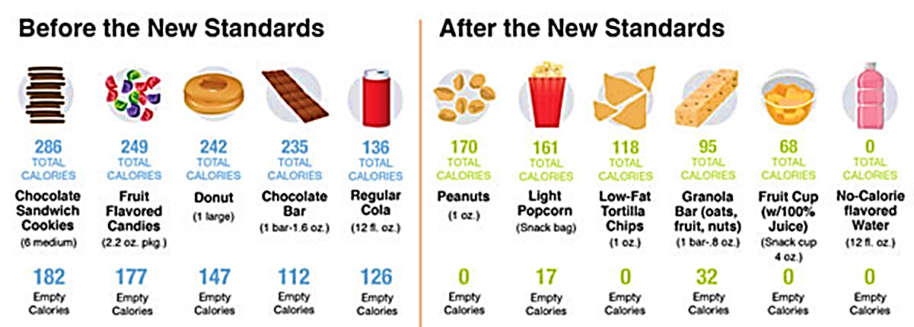
Before & After New Standards
“Good-bye doughnuts, candy bars, high-fat chips, full-calorie soft drinks and chocolate sandwich cookies. Those kinds of foods and beverages will no longer be allowed to be sold in school… Hello granola bars, peanuts, fruit cups, light popcorn, low-fat chips and no-calorie flavored water. Those types of foods will be offered.”
– “ ‘Smart Snacks’ Replacing Junk Food in Schools”, USA Today

Slide 22
Monitoring and Compliance
State agencies will monitor compliance with the standards for all foods sold in schools through a review of local educational agency records as part of the State agency administrative review.
For violations, technical assistance and corrective action plans will be required.

Slide 23

Implementation and Support
  State agencies and schools must implement the new standards by July 1, 2014.
  USDA will provide guidance and technical support to State agencies and local educational agencies prior to and during the implementation process.
  Visit FNS website for guidance: www.usda.gov/healthierschoolday

Slide 24
For More Information
To read more about the new Smart Snacks in School nutrition standards, reference the websites listed below.
Smart Snacks in School: USDA Website
http://www.fns.usda.gov/cnd/governance/legislation/allfoods.htm
USDA’s The School Day Just Got Healthier Toolkit
http://www.fns.usda.gov/healthierschoolday
Smart Snacks in School: Questions and Answers
http://www.fns.usda.gov/cnd/Governance/Legislation/allfoods_QandA.pdf

Slide 25
Healthy Hunger-Free Kids Act
Breakfast Meal Pattern
Breakfast Meal Pattern requirements phased in over the course of two years
  2013-14 SY:
    Follow food-based menu planning approach
    Meet calorie ranges and nutrient standards
    Eliminate trans-fat
    Ensure half of all grains offered are whole-grain rich
  2014-15 SY:
    Follow food-based menu planning approach
    Meet calorie ranges and nutrient standards
    Eliminate trans-fat
    Ensure ALL grains offered are whole-grain rich
    Additional fruit requirement
    Meat/Meat Alternative options may be substituted once Bread/Grain requirement is met
    Intermediate sodium specifications established for 14-15 SY.

Slide 26
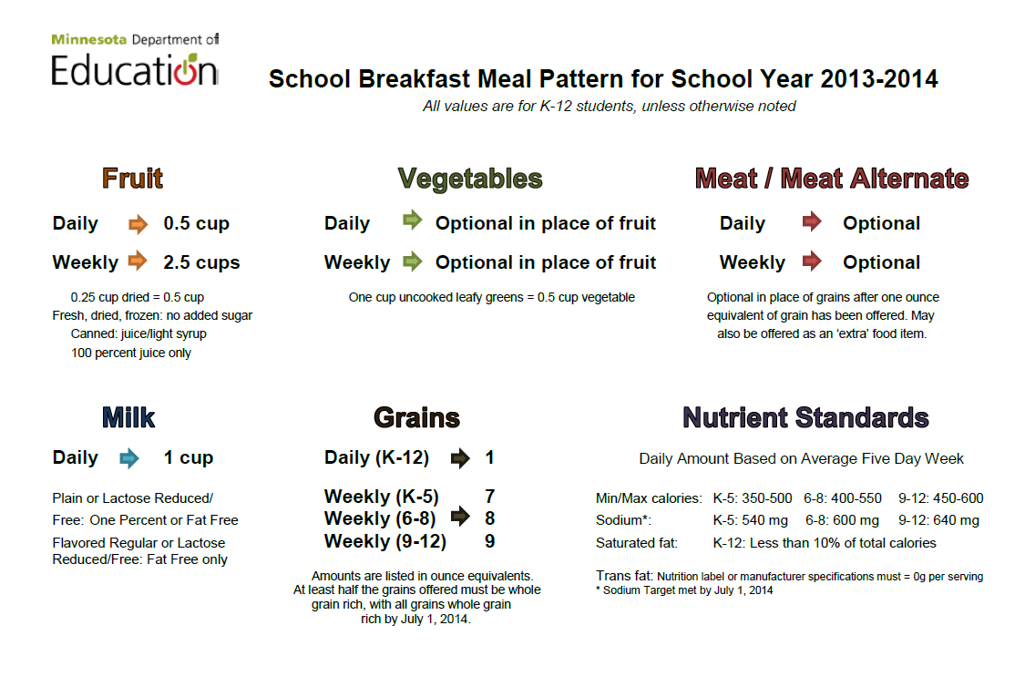

Slide 27
USDA Guidelines for School Meal Programs
School meal standards have been set by USDA since the introduction of the programs in 1946
Standards are supposed to be updated every 5 years with the Dietary Guidelines for Americans
On January 2011, USDA proposed new rules very close to IOM recommendations
The last update before the finalized rule for the Healthy Hunger Free Kids Act, was in 1995

